Slide 1
Project: Analysis of Airbnb Data Using Power BI
Name – Shishir kherod
Email – kherodshishir@gmail.com
Course – ABADS
Batch – Batch 11

Slide 2
Use of Power BI
Power BI, as a business analytics tool developed by Microsoft, doesn't strictly adhere to a specific methodology like CRISP-DM, but it does provide a framework for guiding users through the process of creating meaningful insights from data. The general process in Power BI can be summarized as follows:
Connect to Data Sources
Data Modeling
Enhance with DAX Calculations
Create Dashboards
Publish to Power BI Service
01
02
03
04
05
06
07
08
09
Transform and Clean Data
Create Visualizations
Interactive Analysis
Share and Collaborate
Keep in mind that this process is iterative, and you may go back and forth between steps as you refine your analysis and visualizations. Power BI provides a user-friendly interface, powerful analytics capabilities, and integration with other Microsoft products, making it a popular choice for business intelligence and data analytics.

Slide 3

Business
Objective
The primary objective is to analyse Airbnb data to reveal insights into user experiences and satisfaction levels with the numerous listed stays, all accomplished using Power BI.

Slide 4
Project Goals
01
Assessing District & City Location Scores
02
Examining Host Response Time Impact
03
Visualizing Airbnb Listing Prices
04
Analyzing Composite Scores
05
Calculating Listing Age and Host Tenure
06
Property Type Price Analysis
07
Crafting a Comprehensive City Insights Report

Slide 5
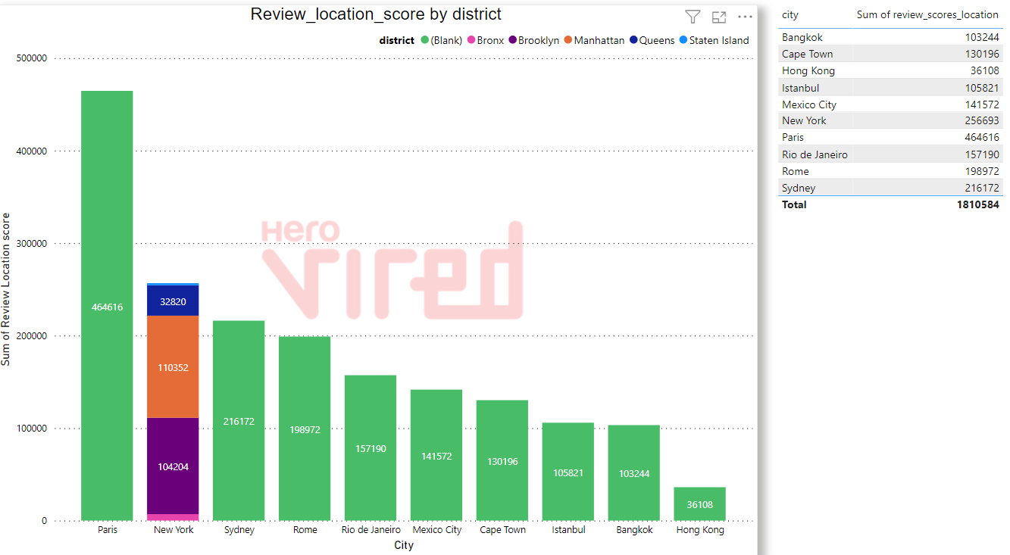
Assessing City & District Location Scores
Paris
464616
New York
256693
Sydney
216172
Rome
198972
Rio de Janeiro
157190
Mexico City
141572
As per the Stacked column chart, the statistics shows that Hong Kong city has the least favourable location score with total of just 36108.
Also Paris city has the most favourable location score with the total of 464616.
Cape Town
130196
Istanbul
105821
Bangkok
103244
Hong Kong
36108

Slide 6
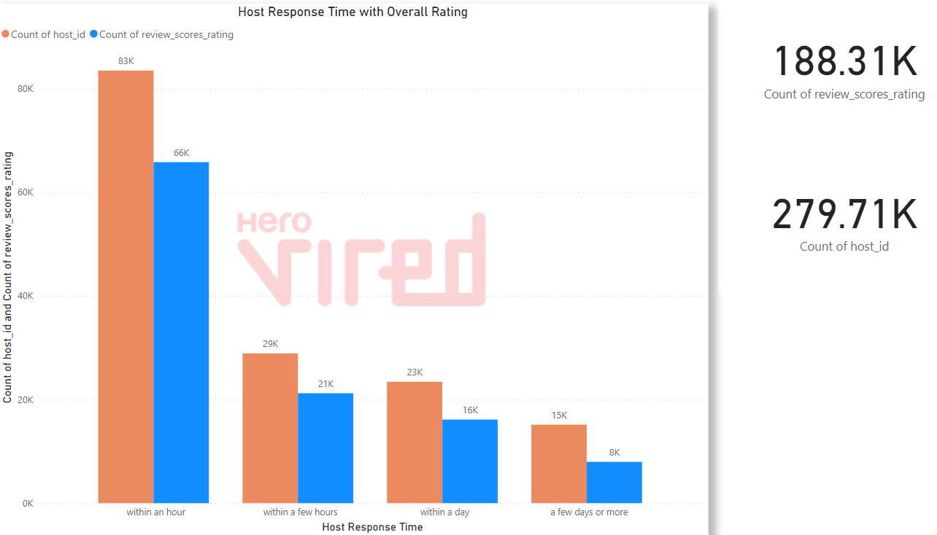
Examining Host Response Time Impact
Count of Host ID / Count of Review Score Rating
83K / 66K
29K / 21K
23K / 16K
15K / 8K
Within an hour
The Clustered Column Chart here shows that 83K of the host response time is within an hour.
Also the host with maximum review score rating of 66K response within an hour.
So customers prefer host which response quickly to their queries.
Within a few hours
Within a day
A few days or more

Slide 7
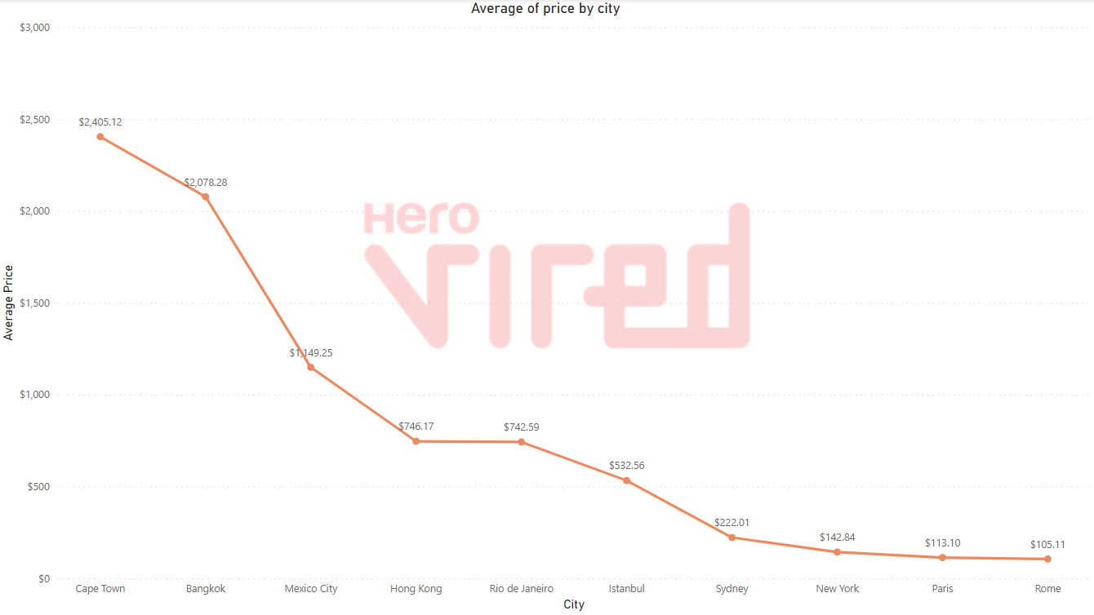
Visualizing Airbnb Listing Prices
Cities
Avg. Price
Cape Town
$2405.12
Bangkok
$2078.28
Mexico City
$1149.25
Hong Kong
$746.17
Rio de Janeiro
$742.59
Istanbul
$532.56
Sydney
$222.01
New York
$142.84
Paris
$113.10
Rome
$105.11
According to line chart analysis Rome city has the best affordable price as compared to others with average price of $105.11

Slide 8
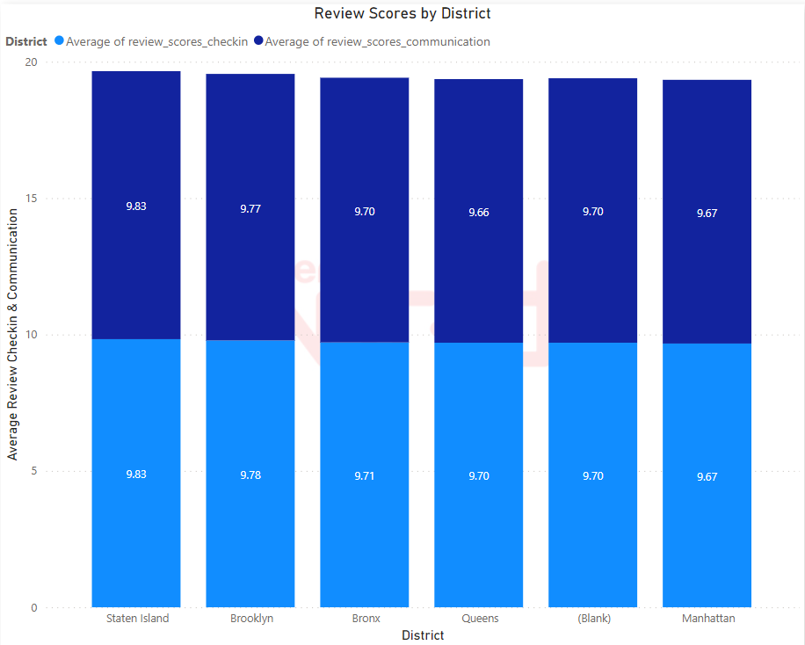
Analysing Composite Scores
Staten Island 9.83
Brooklyn 9.77
Bronx 9.70
Avg. Review score Comm.
Queens 9.66
Blank 9.70
Manhattan 9.67
Staten Island 9.83
Brooklyn 9.78
Bronx 9.71
Avg. Review score Check-in
Queens 9.70
Blank 9.70
According to the stacked column chart here we can see that the Staten Island district has the highest average Review score for communication as well as for check-in which states that host of this district are much interactive in responding to queries and care about a comfortable check-in of their customers.
Manhattan 9.67

Slide 9
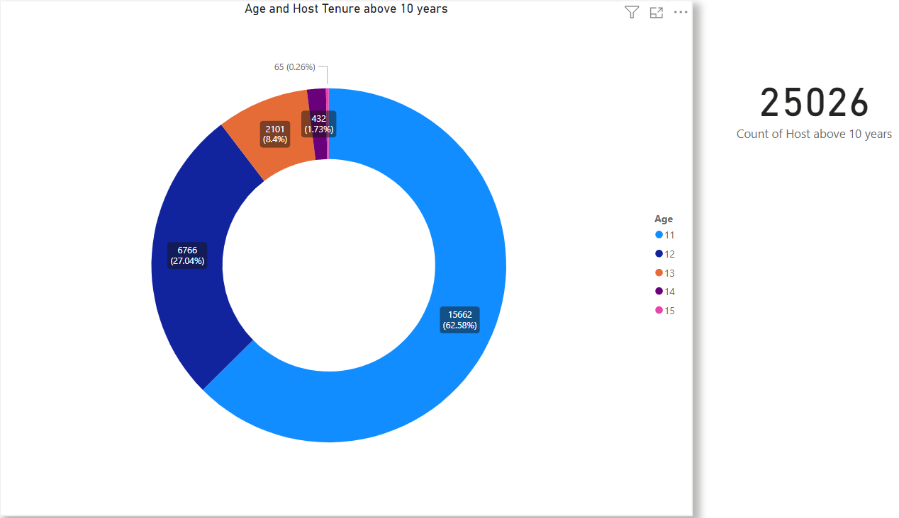
Calculating Listing Age and Host Tenure
Years
No. of Hosts
11
15662 (62.58%)
12
6766 (27.04%)
The respective chart shows here the statistics of total number of listing age and host tenure in years.
Here 15662 no. of host have 11 years of hosting tenure which is the maximum of all other hosts whereas only 65 hosts having 15 years of hosting tenure.
13
2101 (8.4%)
14
432 (1.73%)
15
65 (0.26%)

Slide 10
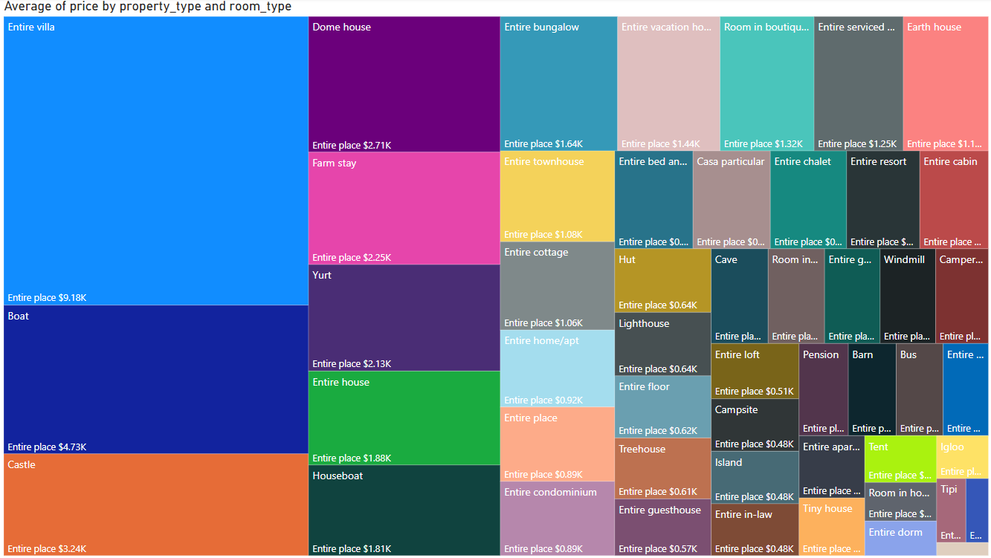
Property Type Price Analysis
The task involves the creation of a visual tree map that displays average prices for various room and property types with specific attention given to the property type associated with the highest prices for entire places.

Slide 11
Crafting a Comprehensive City Insights Report
Listing ID’s by Year
Bar Chart
The presented Bar chart shows the number of Airbnb registered with respect to year. The maximum of which is registered in year 2018 and 2019.
2018 - 265643 Airbnb Registered
2019 - 263137 Airbnb Registered
Avg. Price & Review by City & Room type
Line and Stacked Column Chart
Mexico city - Highest rating 94.84
Bangkok - Highest Average Price
The chart shows the average price and review rating according to the cities and room type. Mexico City has the Highest rating whereas Bangkok has the highest Average price .
Sum of Review Check-in By city
Pie Chart
Paris - 465K Check-in Review Score
New York - 260K Check-in Review Score
The respective pie chart shows the sum of Check-in review score by city where Paris has the most review score followed by New York city.
Count of Airbnb by city and Instant Bookable
Stacked Column Chart
Here the Chart shows the number of Airbnb in the city which can be booked instantly and how many cannot. Paris has the highest Airbnb which can be booked instantly followed by Rome city.
Paris - 21K Instantly Bookable
Rome - 16K Instantly Bookable
Number of Verified Host by city
Line Chart
Paris - 50K Verified Host
Hong Kong - 4K Verified Host
This chart shows the number of verified Host in different cities. Paris has the most Verified host followed whereas Hong Kong City has the lowest Verified Host.

Slide 12
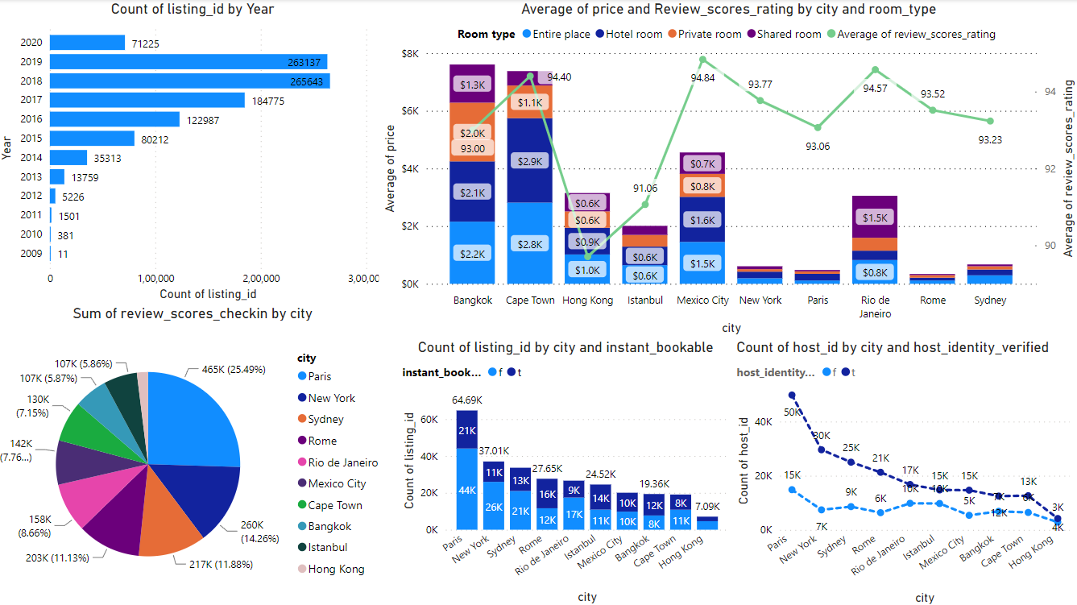

Slide 13
THANK YOU

